Slide 1
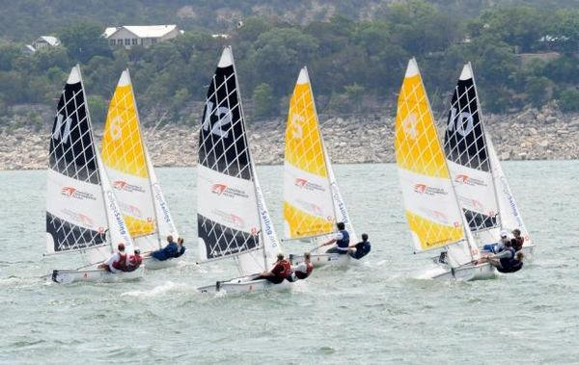
SCIRA Team Race
PROMOTION COMMITTEE

Slide 2
SCIRA Team Race
GOALS
Promote Juniors & Female.
Promote small countries that may organize this kind of events at low cost and resources.
To be a footbridge for incomers to snipe class.
To show that Snipe is more than a fleet boat.
To bring a new, dynamic & exciting side of our class.
To increase appearance in social media and sailing publications.

Slide 3
SCIRA Team Race
RESOURCES
In organizing Team Race Regattas, depending on the courses options, low cost and resources are the main reason.
RIBS: 3 ribs required (Jury, marksettle and RC boat)
MARKS: 2 course marks + 1 buoy for the starting / finish line
RACE OFFICE: Not necessary
MEASUREMENTS: Not necessary
STAFF: 5 – 6 people (2 RC boat + 1 mark settle + 2 juries)

Slide 4
SCIRA Team Race
TEAMS
To promote the Junior & Female members in Snipe Class, each team must have two female and two junior members.
There is no limit in changing positions. It means that a skipper in one Round Robind race may be a crew for other race but always within his /her team. The members of a Team can move freely from a position in a boat to other.
It is permited the change of position in a boat while racing.
THREE (3) BOATS TEAM
FOUR (4) BOATS TEAM
Pros:
Cheap in travel
Small courses (5-7 minutes) that may be settle close to club to follow races
Easy to find boats for those not bringing their own boats
Only 1 jury boat required
Easy for small countries to attend
Against:
Less exciting situation while racing
Pros:
Very active races and exciting situations
Against:
Expensive in travel (8 people)
Courses have to be enough big to hold inside 8 boats
Increases the difficulty for finding boats for those not bringing their own boats
Probably, the fleet will divide in 2 groups (4 ahead and 4 back fighting), so 2 jury boats required.

Slide 5
SCIRA Team Race
COURSES
OPTION A
OPTION B
Finish
ENTRENADOR
CLUB NÁUTICO
Start
Finish
ENTRENADOR
CLUB NÁUTICO
Start
ENTRENADOR
CLUB NÁUTICO

